Slide 1

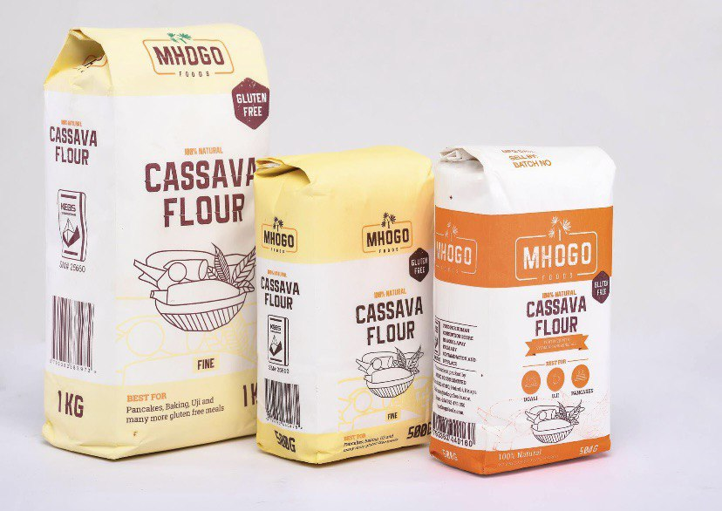


YARP
FORTIFIED
YARP
FORTIFIED
Every baker’s savior…

Slide 2
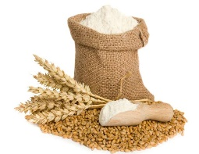




Introduction
Total Cassava Production
Ghana produces 22 million tons of cassava each year.
The Irony…
$246 million worth of wheat is imported annually to make flour.
What Happens ?
10 million tons remain unuprooted, while only 0.5% is processed.
Where we come in…
YARP Foods uses cassava to produce fortified cassava flour as a substitute for wheat flour.

Slide 3
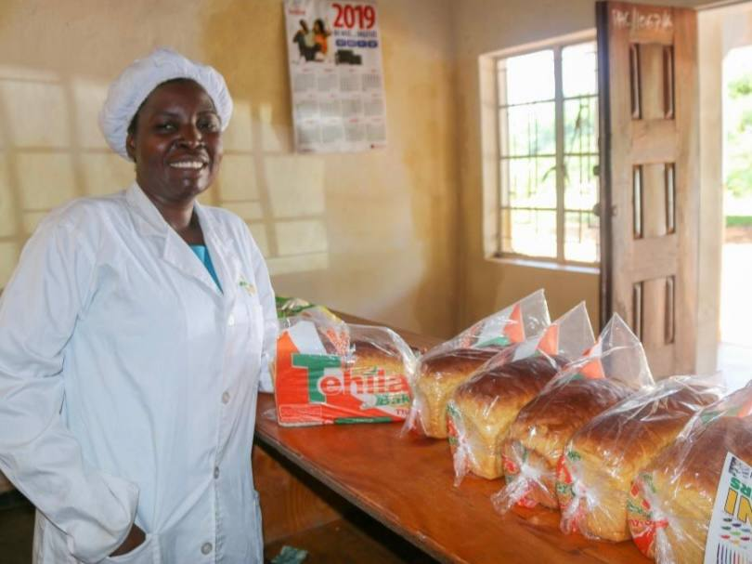
Customer Persona
Meet Madam Theresa
This is as a result of the skyrocketing price of wheat flour that has occurred over the past year.
the CEO of BB Super Fine Bakery
She used to bake 350 bags of flour a day. This has been reduced to 170 bags.
She is forced to lay off a lot of workers.

Slide 4
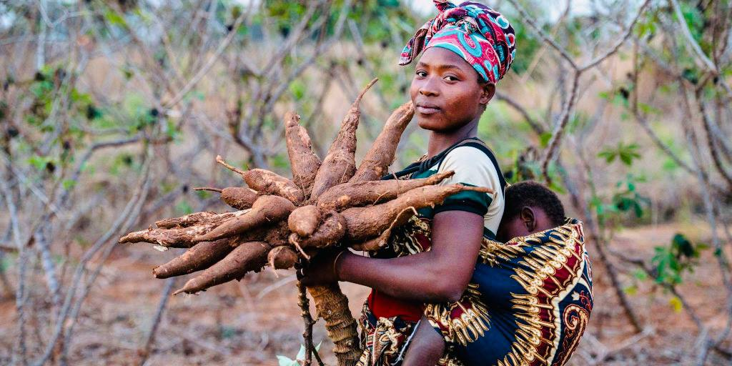
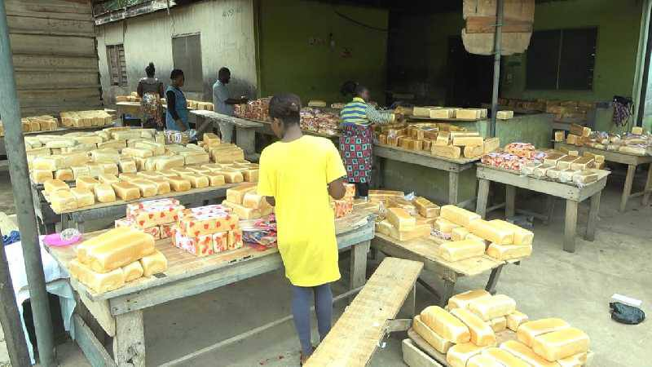

The Problem
FARMER
INDUSTRIES
The cassava value chain faces a loss of 10 million tons.
Huge wheat flour importation costs are raising production costs.
Pushing most flour users, like BB Bakery, out of business.
Reduces farmers income.

Slide 5
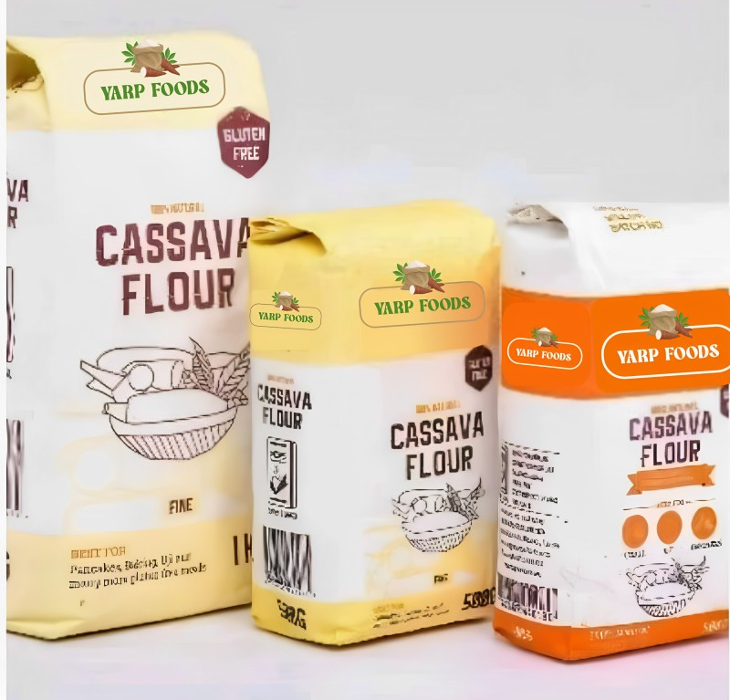
Our Solution
Fortified cassava flour is an alternative, high-nutrient, and cost-effective flour.
Extract cassava starch for the food, pharmaceutical, paper, and textile industries.
Offer a range of valuable by-products from cassava flour

Slide 6
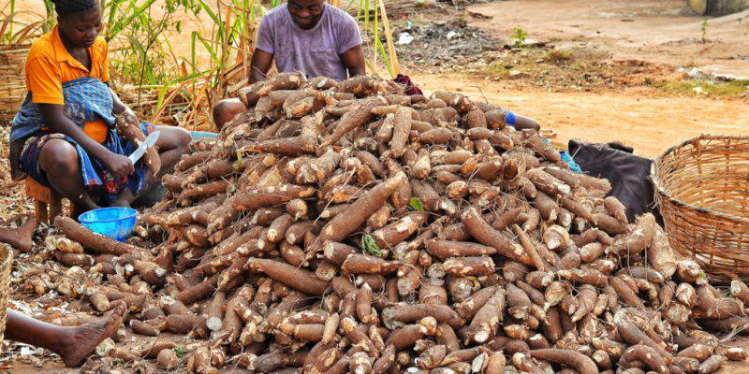
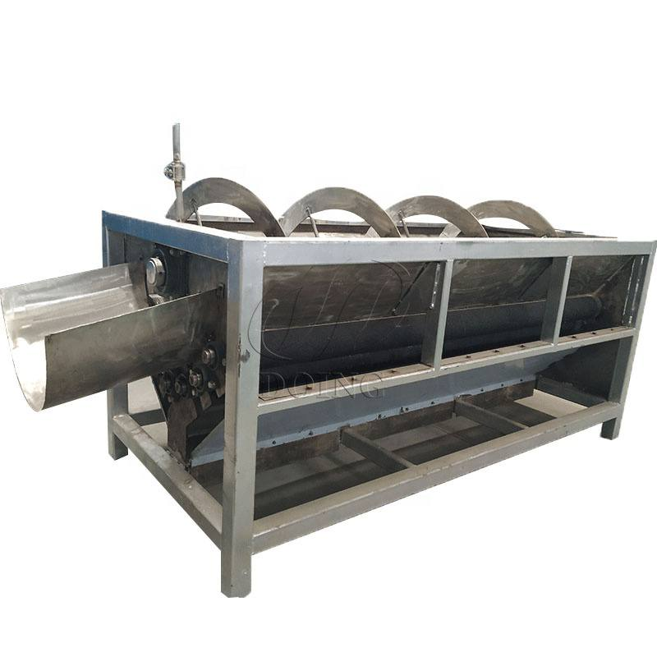
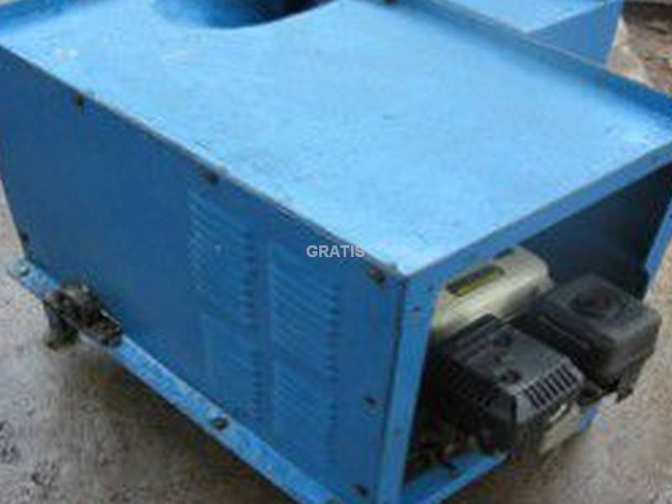
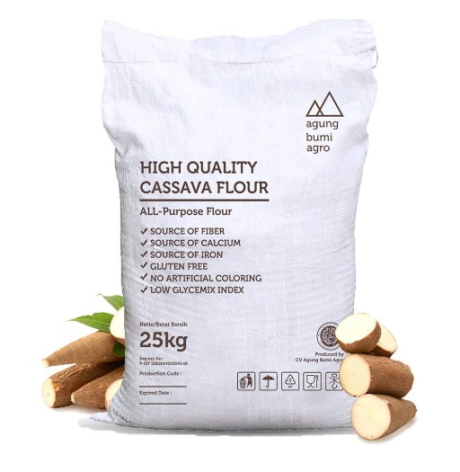
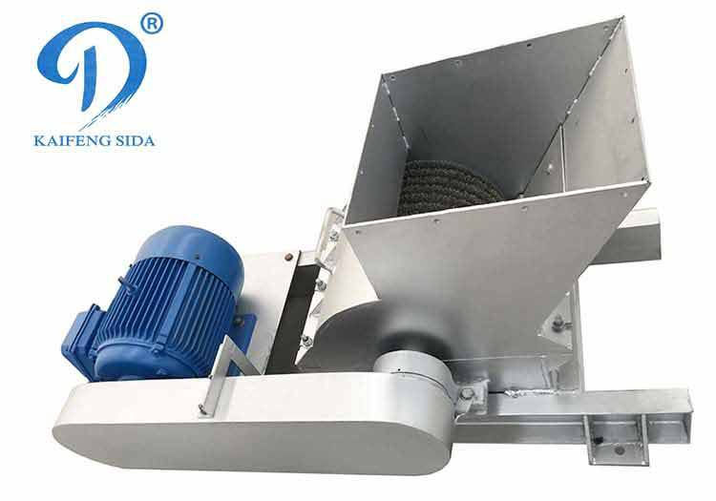
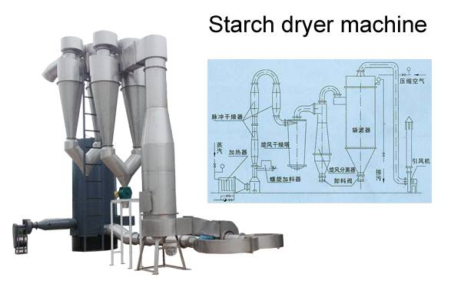
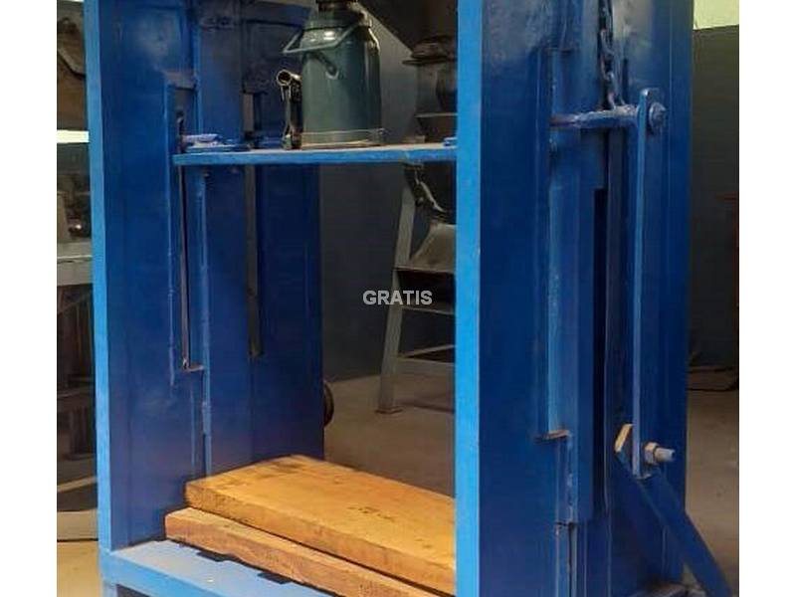
How It Works
Cassava Peeling
Cleaning
Crushing
Packing
Milling
Drying
Dewatering

Slide 7




Value Proposition
Value Proposition
Highly refined and better quality
Our flour is highly refined and of better quality
Cost Effective alternative
Save 30% on production costs as compared to wheat flour.
Health and Nutrition
Fortified cassava flour contains protein, carbohydrates, fiber, minerals, and vitamins.
Market Versatile
Cassava flour is a suitable for a wide range of products, including bread, pastries, and fufu flour.

Slide 8












Impact on Small Holder farmers.
Cassava farmers will get additional revenue of about $44,595 per season, which is a 30% increase in their income.
Increased employment
10 direct jobs, 2 indirect jobs, and 4 jobs in our farm center would be created within one year of operation.
1
2
Women and Vulnerable group Empowerment.
70% of workers to be employed will be women, and vulnerable group.
IMPACT
3
4
Farmers support service
10% of the annual profit will be set aside to support cassava farmers.
5
Impact on Environment
Processing cassava peels will help reduce emissions of methane, which contributes to climate change.

Slide 9

Competitor Analysis
Competitor
Low Price
Fortified
Farmers supportive system
Source of raw material
YARP foods
 |  |  | Local
(600 50kg) |  |  | Local
(598 50kg) |  |  | Local
(587 50kg) |  |  | Imported
(450 50kg)
Christaa Agri Ventures
Fountain flour
Takoradi Flour Mill

Slide 10










Collaborators & Partners
MoFA
Ghana Bread Bakers Association

Slide 11
Market Size
SAM
$25.8m
(Ghana market Size)
$19Bn
SOM
$3.87m
TAM
$34 Bn
(Africa market Size)
(Target market Size)
Source: Food Dive/ Tridge

Slide 12

Go-To-Market-Strategy
Awareness
Target Market
Distribution
1. Bread bakers
2.Food& Pharmaceutical companies
3. Wholesalers
4.Retail Outlets (stores, supermarkets, Malls)
6. Export
1.Target market engagement.
2.TV & radio advertisements.
3.Market display & Exhibitions
.
4.Digital marketing.
5.Collaborations & Partnerships
Shops, malls & Supermarkets
Website & Delivery
Air and Sea Freight

Slide 13

Market Research Findings
Availability of raw materials
80.5 tons of cassava will be needed monthly. About 1.32 million tons of cassava goes to waste every annually on the average in the Bono Region (FAO, 2012), and hence can guarantee 100% supply of raw.
1
Feasibility of business
Ghana's potential for a cassava flour company is significant due to its local demand, cultural significance, export potential, and increasing gluten-free consumer preference.
2
Value addition proposition Nutritional
Fortified cassava flour enhances cassava's cultural significance by providing a convenient, nutrient-rich staple, catering to local dietary preferences and addressing nutritional challenges in Ghana..
3
Competition
The cassava processing industry faces intense competition for raw materials, driven by the growing demand for healthier, gluten-free options among Ghanaians.
4
5
Patronage
90% of the bakers and pastries companies visited are currently using wheat flour, which is expensive, and are willing to switch to fortified cassava flour should it be more affordable and nutritious.

Slide 14

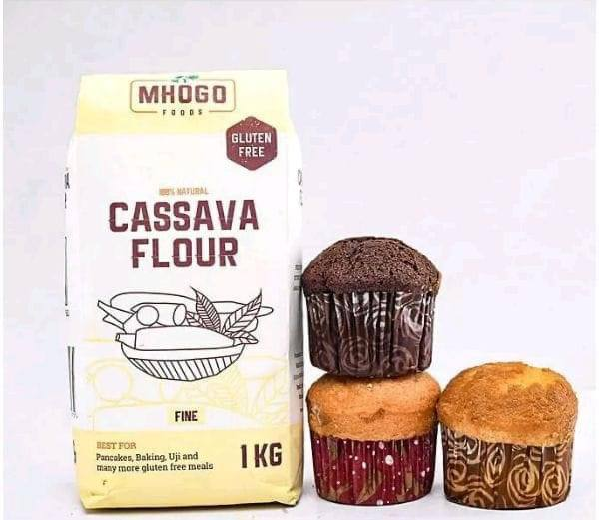
Revenue Model
All purpose Cassava flour 50 kg bag
Fortified Cassava flour 50 kg bag
Unit Cost: | $ 25.34
Selling Price: | $ 31.25
Profit Margin: | 18.9%
Unit Cost: | $ 31.25
Selling Price: | $ 38.00
Profit Margin: | 17.8%
Cassava Peels 50kg bag
Starch Cassava from wastewater 1 kg bag
Unit Cost: | $ 1.69
Selling Price: | $ 4.22
Profit Margin: | 60%
Unit Cost: | $ 0.84
Selling Price: | $ 1.35
Profit Margin: | 37.5%

Slide 15

Financial Projections
DESCRIPTION | Q4 2023 ($) | Q1 2024 ($) | Q2 2024 ($) | Q3 2024 ($)
Cash Sales | - | - | 38,388.52 | 57,576.01
Receivable Collected | 591.22 | 2500 | 25,000 | 25,000.00
Total Cash Inflow | 591.22 | 2500 | 63,388.52 | 82,576.01
Expenses:
Market Research | 211.15 | - | - | -
MVP development | 380.07 | - | - | -
Transport |  | 42.23 | 590.93 | 1,688.36
Raw materials |  | 253.35 | 6,017.31 | 12,034.62
Packaging Materials |  | 50.67 | 190.93 | 400
Lab Chemicals |  |  | 84.42 | 100.23
Purchase of Capital Assets:
Factory site, farm land(30) and building |  |  | 3,716.21 | 3,798.81
Documentation and Premises development |  | 25.33 | 211.04 | 422.09
Machines (Chipper, Grinder, dehydrator,pressor) |  | 591.16 | 12,486.49 | 5,000
Equipment's and Tools |  | 100 | 396.11 | 844.59
Supply centers (rent) |  |  | 506.51 | 1,182.43
Vehicles |  |  | - | 5,065.08
Stipend:
Salaries (42.21 per person - 4 permanent employees) |  |  | 168.83 | 506.51
Labour ( $150 per Labourers/Month) |  | 50 | 1000 | 1,950.05
Utilities:
Water |  | 5 | 16.88 | 25.33
Electricity Bills |  | 10 | 84.42 | 168.84
Total Cash Outflow | 591.22 | 1,127.74 | 25,470.08 | 33,186.94
Net Cashflow | 0 | 1,372.26 | 37,918.44 | 49,389.07
Opening Cash Balance | 0 | 0 | 1,372.26 | 39,290.7
Ending Cash | 0 | 1,372.26 | 39,290.7 | 88,679.77

Slide 16

Product Roadmap
Jul-Sep 2024
Full product Deployment/ marketing and sales /cassava farming to supply factory
Oct-Dec 2024
Cassava peel feed, Cassava flour noodles, and pastries product development
Apr- Jun 2024
Setting up processing facility, Business registration and FDA registration and testing Feedback collection, Publicity
Jan- Mar 2024
Identification of sources of raw materials.
Product launching, Feedback acquisition,
Customer Acquisition
Sept-Dec 2023
Market Research, Business Development, MVP testing
Securing Partnerships, Product Development
4
5
3
2
1

Slide 17




Meet The Team
Andy Donsah Yeboah
Team & Production Lead
Chemist & 4 yrs. expert in food chemistry
Amponsah Ankrah Richard
Agri Research & Admin. lead
Agri Engineer & 4 yrs. expert in post-harvest lost
Louisa Yeboah
Business develop & Marketing lead
BSC Hospitality & Business Management
Otu Prince
Operation lead
Mechanical Engineer & machinery expert

Slide 18
The End
Thank You

